Slide 1
Introduction to Immunology
Assist. Professor
Dr. Sinan Bahjat
M.B.Ch.B., M.Sc., F.I.B.M.S.

Slide 2
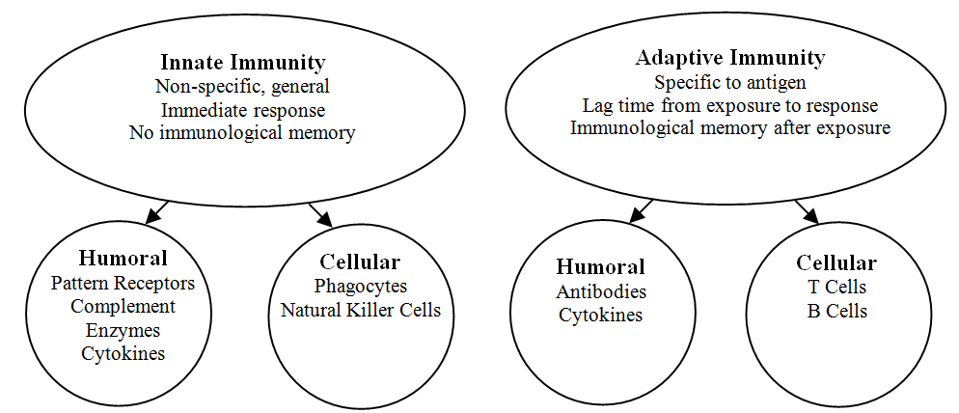
The main function of the immune system is to prevent or limit infections and fight diseases. Our immunity is composed of two arms: the Natural (or Innate) arm and the Acquired (or adaptive) arm.

Slide 3
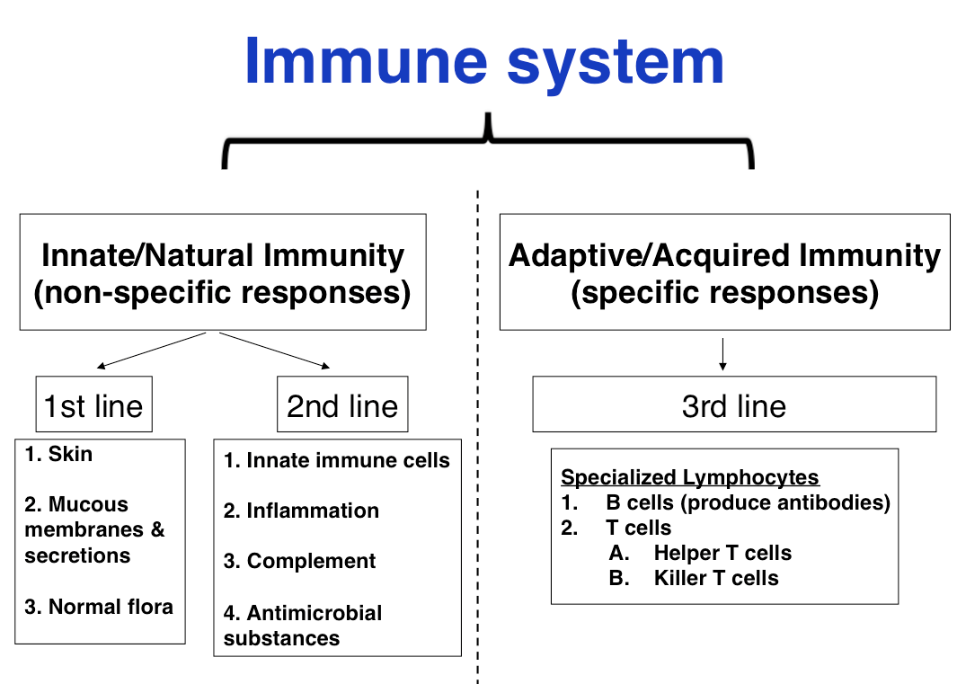
The Innate immunity is considered as the first and second lines of defense against foreign subjects in our body, while the adaptive immunity is the third line of defense.

Slide 4
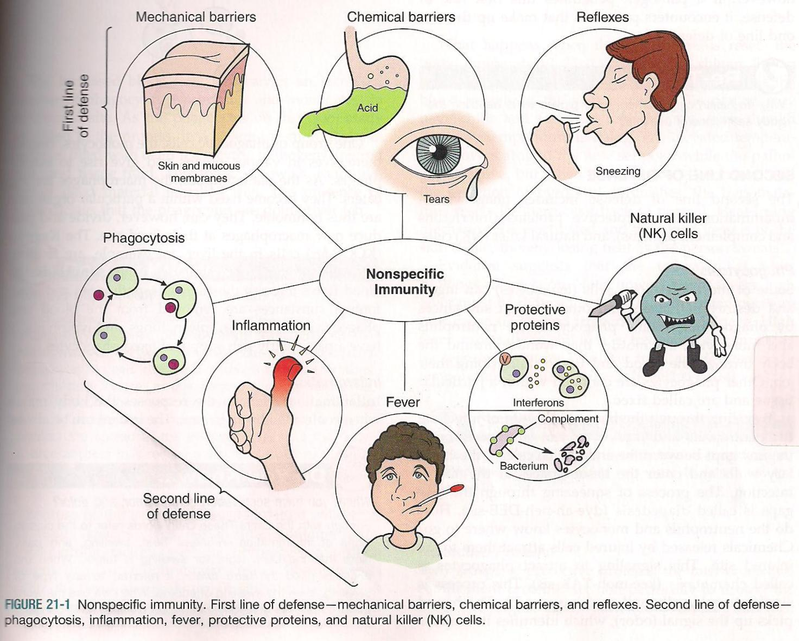
The first line of defense against the microorganisms is the intact skin and mucous membranes, along with many other physical and mechanical barriers.

Slide 5
If the micro-organisms breach this line and enter the body, then the innate arm of the immune system (second line of defense) is available to destroy the invaders.

Slide 6
The second line of defense consists of:
phagocytic cells (i.e. granulocytes, macrophages, natural killer cells, and dendritic cells).
Inflammation; which is one of the important mechanisms of defense against diseases.
Fever; which can change the environment of the invading microorganisms.

Slide 7
Protective proteins; like the complement system proteins and interferons.
Natural killer cells; which are non- specified lymphocytes that can attack the non- self subjects.

Slide 8
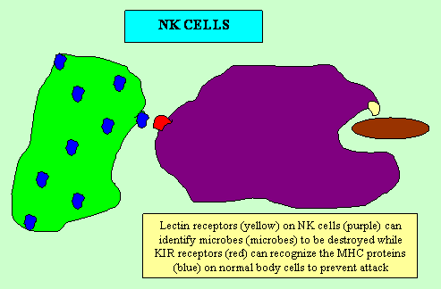
The Innate immune system has the ability to distinguish between non- self antigens (i.e. proteins that can elicit an immune response) which can invade the body from our self antigens. This is performed through a specific receptors called Pattern Recognition Receptors (PRR).

Slide 9
The components of the innate arm are preformed and fully active, and they can function immediately upon entry of the microorganisms.

Slide 10
The ability of the innate arm to kill microorganisms is not specific. For example, a neutrophil can ingest and destroy many different kinds of bacteria.

Slide 11
Highly specific protection is provided by the adaptive (acquired) arm of the immune system (third line of defense), but it takes several days for this arm to become fully functional.

Slide 12
The two components of the adaptive arm are cell-mediated immunity and antibody-mediated (humoral) immunity.

Slide 13
Adaptive immunity refers mainly to antigen- specific immune response. The antigen first must be processed and recognized. Once an antigen has been recognized, the adaptive immune system creates an army of immune cells specifically designed to attack that antigen.

Slide 14
Adaptive immunity cells also includes a "memory" that makes future responses against a specific antigen more efficient.

Slide 15
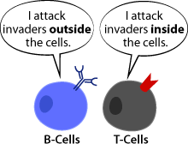
Unlike the innate immune system, the adaptive immune system relies on fewer types of cells to carry out its tasks; the B cells and the T cells. Both are lymphocytes that are derived from specific types of stem cells present in the bone marrow.

Slide 16
After they have been made in the bone marrow, they need to mature and become activated. Each type of cell follows different paths to their maturation.

Slide 17
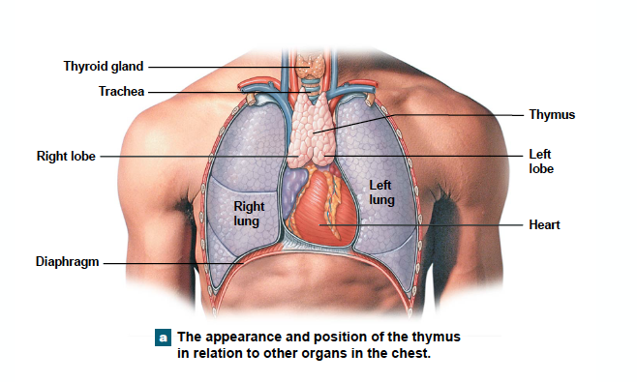
The T-cells differentiation occurs in the Thymus gland (mainly into helper T- cells and cytotoxic T- cells), and have a specific receptor for a fragment of antigen.

Slide 18
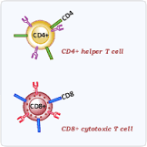
Cytotoxic T-cells contain a surface protein called CD8. These cells can destroy pathogen infected cells, cancer cells, and foreign cells (e.g. transplanted organs). Helper T-cells contain a surface protein called CD4 and act by regulating both cellular and humoral immune systems.

Slide 19
The main functions of cell-mediated immunity (CMI) are to kill virus-infected cells and to inhibit organisms such as fungi, parasites, and certain intracellular bacteria such as Mycobacterium tuberculosis. CMI can also kill cancer cells that often form new antigens on their surface which are recognized as foreign.

Slide 20
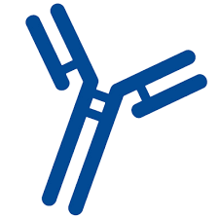
The humoral component of the adaptive immunity is also called “Antibody- mediated immunity”. It involves substances that are found in the humors (i.e. body fluids) like antibodies, in addition to cytokines.

Slide 21
The B- cell is the one that is responsible for producing antibodies after a process called “Differentiation”. This process depends mainly on detection of antigen by the aid of helper T-cells.

Slide 22
The main functions of antibodies are (1) to neutralize toxins and viruses and (2) to opsonize bacteria, making them easier to phagocytize. Opsonization is the process by which immunoglobulin G (IgG) antibody and the C3b component of complement enhance phagocytosis.

Slide 23
Other component of the humoral immunity is the cytokines, which are small proteins important in cell signaling (e.g. Interleukins and Interferon).

Slide 24
Both the cell-mediated and antibody-mediated responses are characterized by 3 important features:
They exhibit remarkable diversity (i.e., they can respond to millions of different antigens)
They have a long memory (i.e., they can respond many years after the initial exposure)
They exhibit exquisite specificity (i.e., their actions are specifically directed against the antigen that initiated the response)

Slide 25
Macrophages and dendritic cells participate in both arms of the immune response. They are considered as a bridge between the two arms. As part of the innate arm, they ingest and kill various microbes. They also present antigen to helper T cells, which is the essential first step in the activation of the adaptive arm.

Slide 26
Thank You

